Slide 1
tim.menzies@gmail.com
GALE: Geometric active learning for Search-Based software Engineering
Joseph Krall, LoadIQ, Nevada Tim Menzies, CS, NC State
Misty Davies, NASA AMES
FSE’15, Sept 2015

Slide 3
Roadmap
Background

Slide 4
Q: What comes next, after “big data”? A: “Big model” • After collecting all that data • Ae are going to aggregate it.

Slide 5
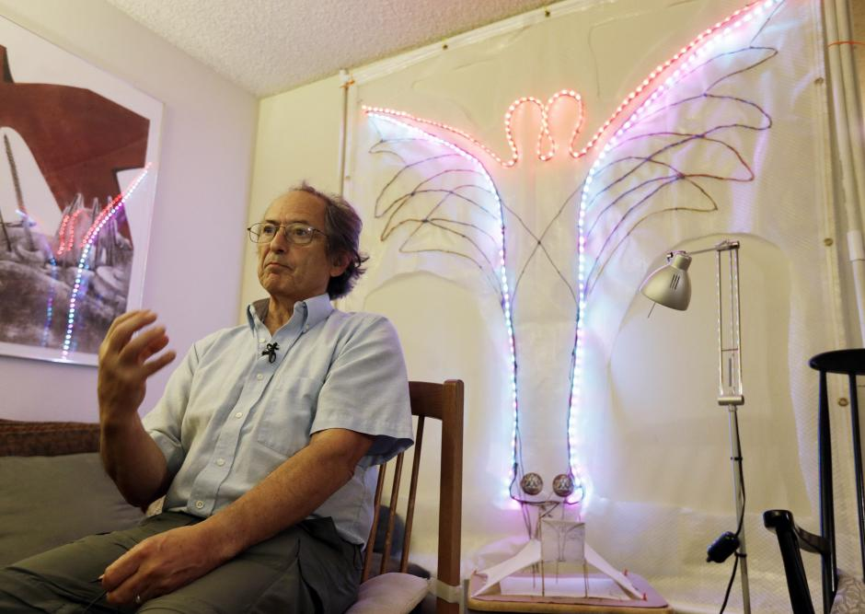
Models: everywhere
Models are now a central tool in scientific research.
in physics, biology and other fields of science
complex simulations using supercomputers.
E.g. genomic map required analyzing 80 trillion bytes
E.g.. Other computational modeling projects
the rise and fall of native cultures,
subnuclear particles
the Big Bang.
Karplus and Levitt
2013 Nobel prize in chemistry
development of multi-scale models for complex chemical systems
Explored complex chemical reactions (e.g. split-second changes of photosynthesis).

Slide 6
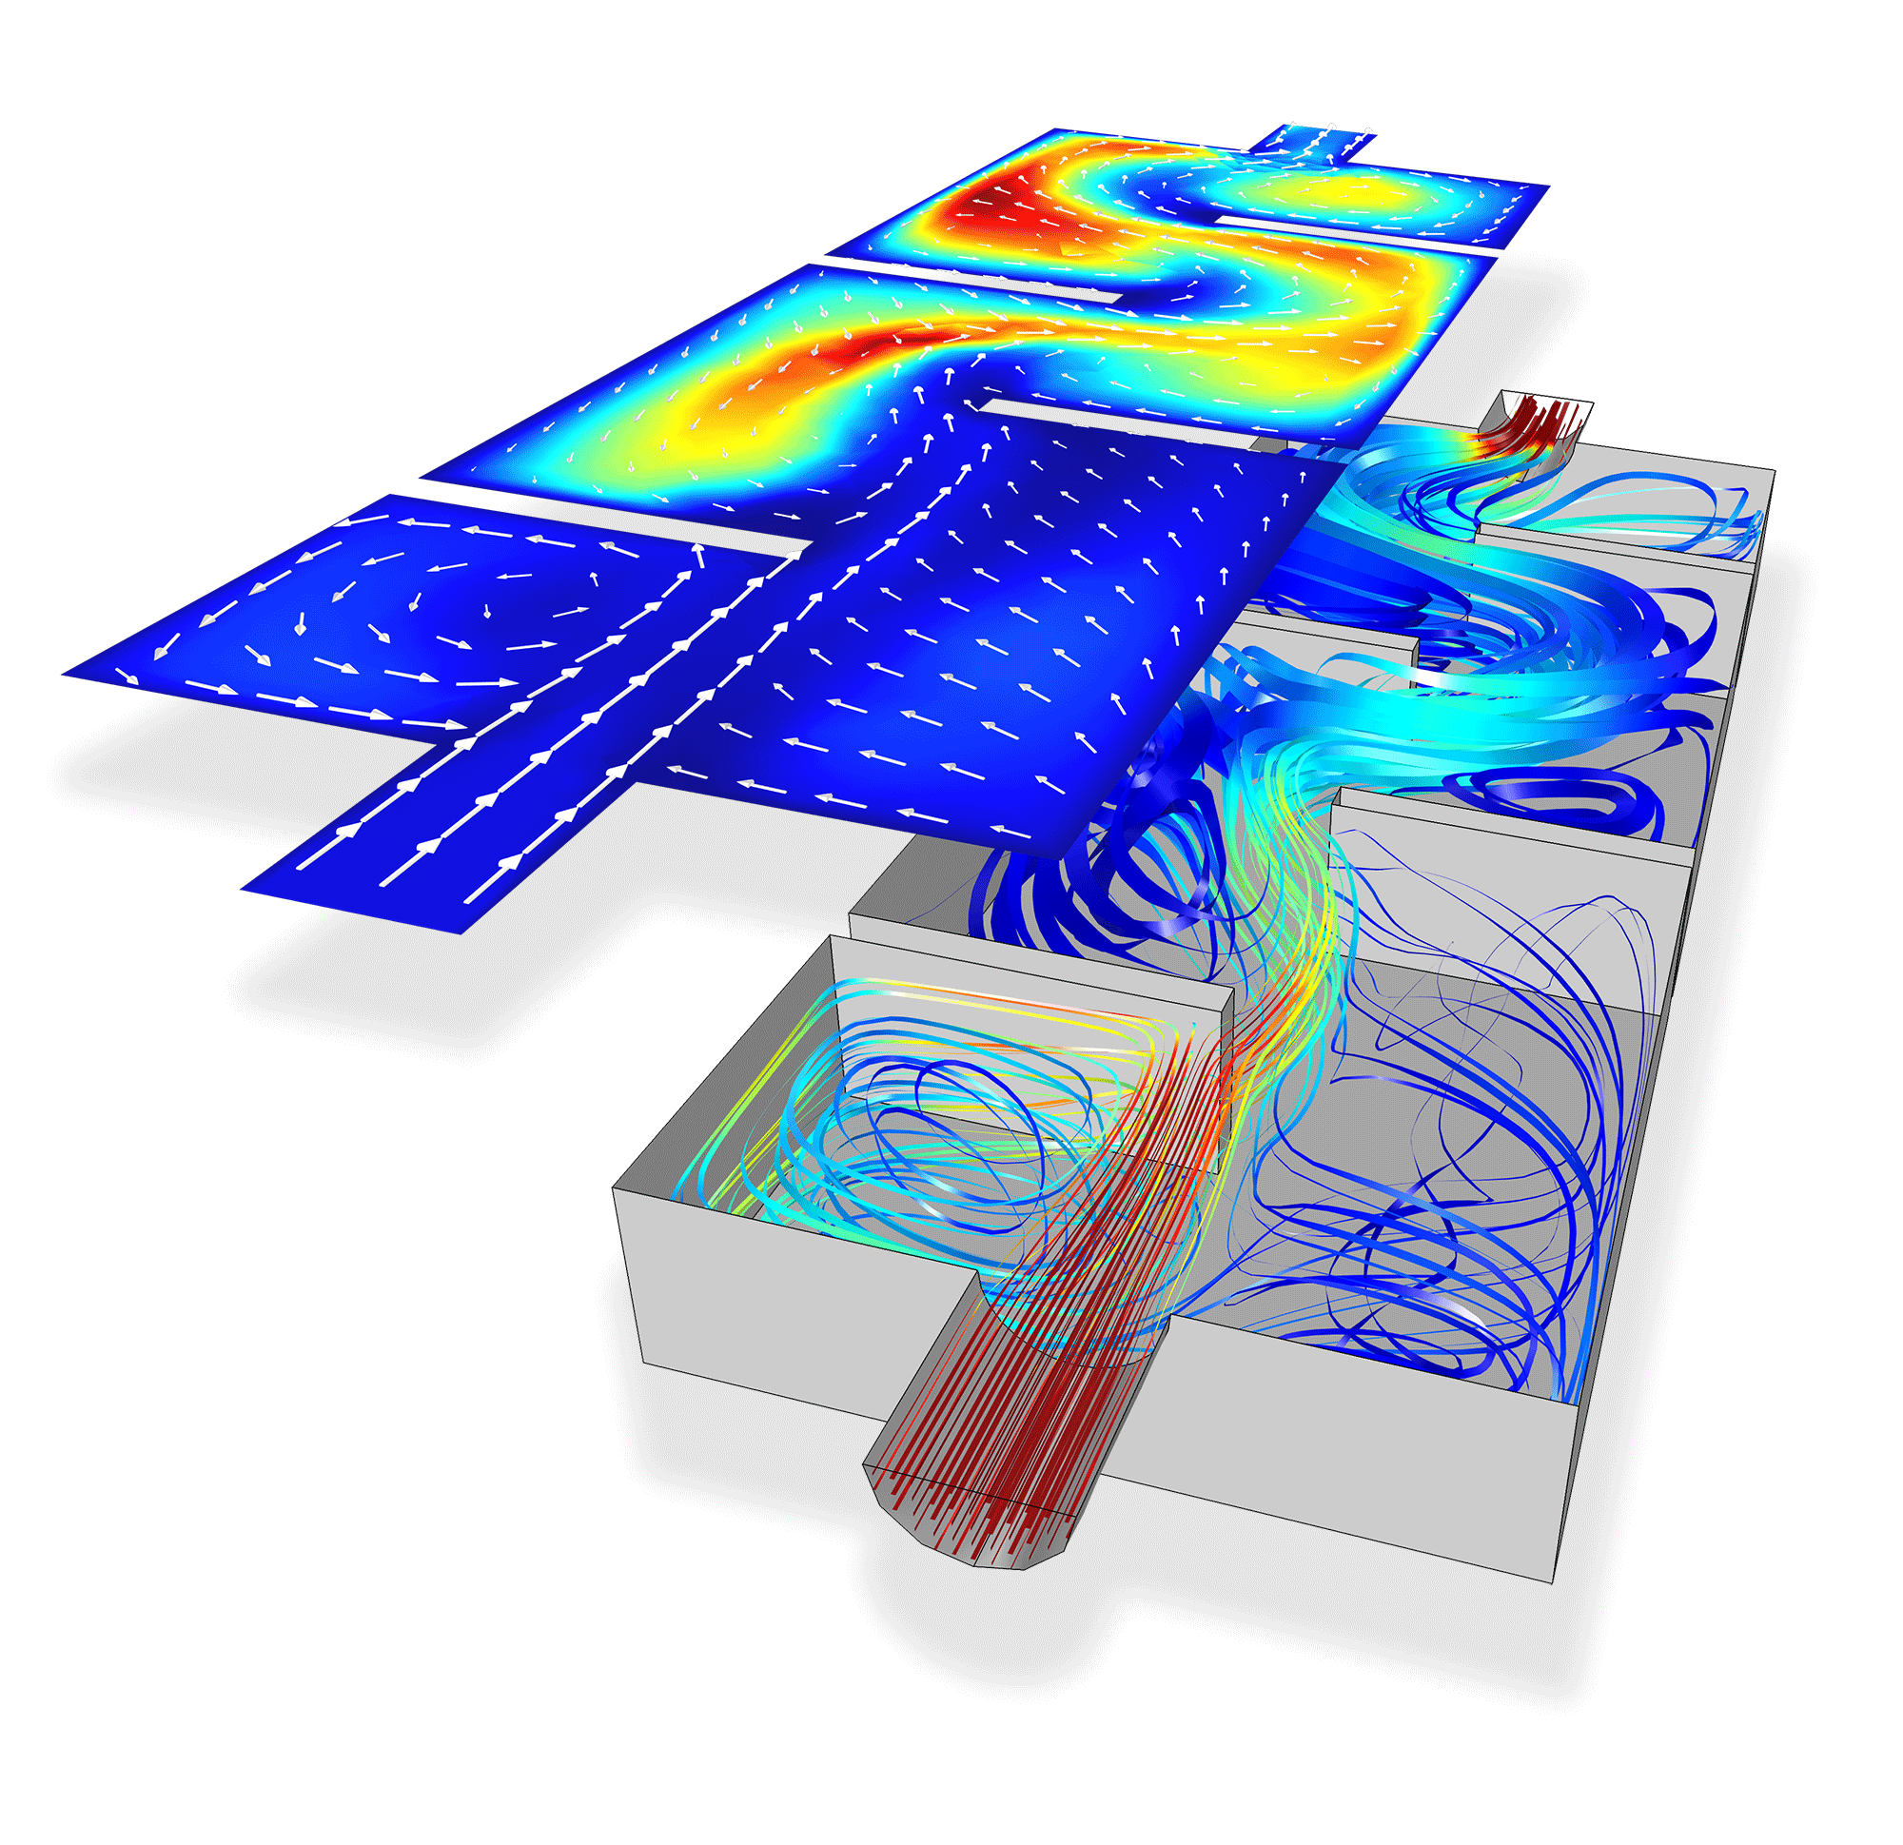
Models: everywhere
If you call an ambulance in London or New York,
those ambulances are controlled by emergency response models.
If you cross the border Arizona to Mexico,
A models determines if you are taken away for extra security measures.
If you default on your car loans,
A model determines when (or if) someone to repossess your car.
If the stock market crashes,
it might be that some model caused the crash.

Slide 7
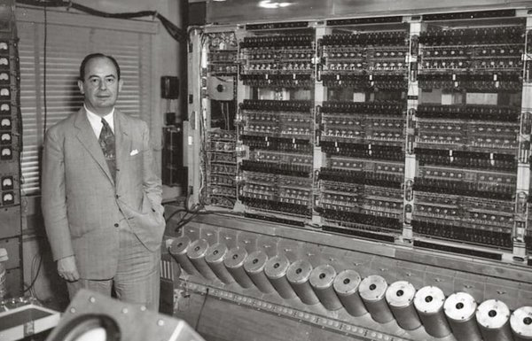
Long tradition of software, simulation, and optimization
Not one “best” solutions
Its all trade-offs
Satisficing = satisfy + sacrifice
Problems have to be explored via computer simulations
Try it out and see
And approach pioneered by John Von Neumann, in the 1950s

Slide 8
Search-based SE
﻿Many SE activities are like optimization problems [Harman,Jones’01].
Due to computational complexity, exact optimization methods can be impractical for large SBSE problems
So researchers and practitioners use metaheuristic search to find near optimal or good-enough solutions.
E.g. simulated annealing [Rosenbluth et al.’53]
E.g. genetic algorithms [Goldberg’79]
E.g. tabu search [Glover86]

Slide 9
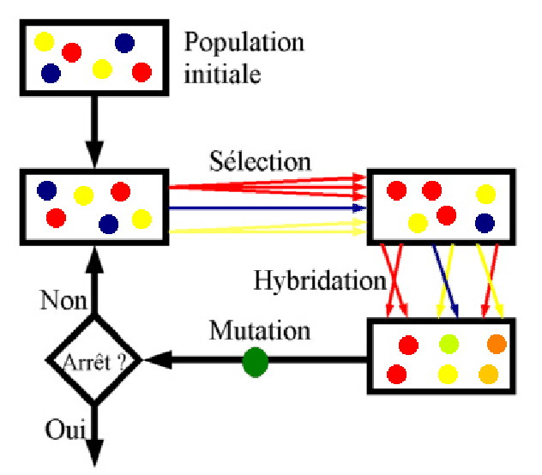
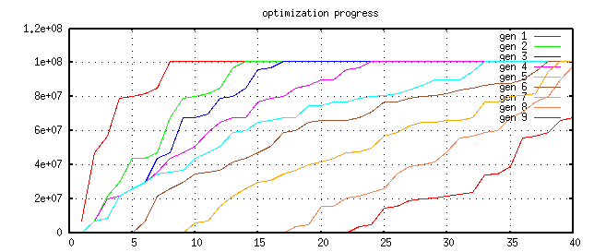
Optimization and evolutionary algorithms
Repeat till happy or exhausted
Selection (cull the herd)
Cross-over (the rude bit)
Mutation (stochastic jiggle)
Pareto frontier
-- better on some criteria, worse on none
Selection:
-- generation[i+1] comes from Pareto frontier of generation[i]
9
8
7
6
5
4
3
2
1

Slide 10
Applications of Optimization in SE
1. Requirements Menzies, Feather, Bagnall, Mansouri, Zhang
2. Transformation Cooper, Ryan, Schielke, Subramanian, Fatiregun, Williams
3.Effort prediction Aguilar-Ruiz, Burgess, Dolado, Lefley, Shepperd
4. Management Alba, Antoniol, Chicano, Di Pentam Greer, Ruhe
5. Heap allocation Cohen, Kooi, Srisa-an
6. Regression test Li, Yoo, Elbaum, Rothermel, Walcott, Soffa, Kampfhamer
7. SOA Canfora, Di Penta, Esposito, Villani
8. Refactoring Antoniol, Briand, Cinneide, O’Keeffe, Merlo, Seng, Tratt
9. Test Generation Alba, Binkley, Bottaci, Briand, Chicano, Clark, Cohen, Gutjahr, Harrold, Holcombe, Jones, Korel, Pargass, Reformat, Roper, McMinn, Michael, Sthamer, Tracy, Tonella,Xanthakis, Xiao, Wegener, Wilkins
10. Maintenance Antoniol, Lutz, Di Penta, Madhavi, Mancoridis, Mitchell, Swift
11. Model checking Alba, Chicano, Godefroid
12. Probing Cohen, Elbaum
13. UIOs Derderian, Guo, Hierons
14. Comprehension Gold, Li, Mahdavi
15. Protocols Alba, Clark, Jacob, Troya
16. Component sel Baker, Skaliotis, Steinhofel, Yoo
17. Agent Oriented Haas, Peysakhov, Sinclair, Shami, Mancoridis

